Slide 1
Presentation & Demo of KBA Local Toolbox
February 17, 2022
Meg Southee
Notes:
Explanation of the tools & demo (prepared project)
Tool outputs & interface
How to install tools & demo (new project)
Install toolbox & tool dependencies
Error handling & tool messages

Slide 2
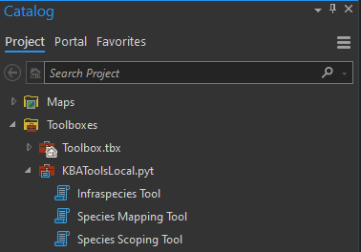
Species & Infraspecies tools in the toolbox
Species Scoping Tool
Creates separate group layers for full species and each infraspecies
SEPARATE OUTPUTS
Species Mapping Tool
Creates a single group layer for full species and all its infraspecies
MERGED OUTPUTS
Infraspecies Tool
Creates a group layer for the infraspecies + separate group for parent species (optional output based on yes/no toggle)

Slide 3
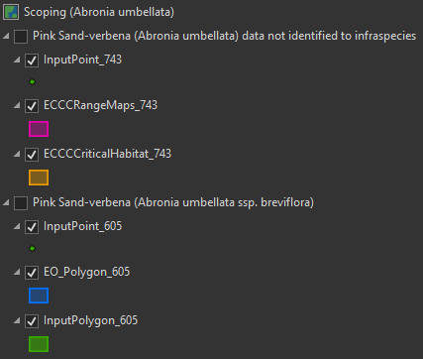
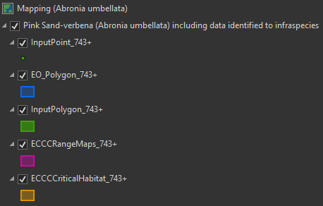
Species tool outputs
Species Scoping Tool
Creates separate group layers for full species and each infraspecies
Species Mapping Tool
Creates a single group layer containing full species and all infraspecies
SEPARATE OUTPUTS
MERGED OUTPUTS

Slide 4
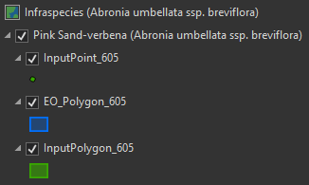
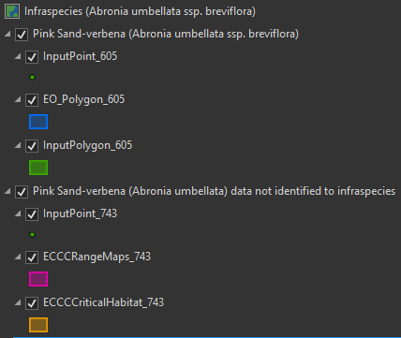
Infraspecies tool outputs
Infraspecies Tool (Toggle = No)
Creates a group layer for selected infraspecies
Does not process the parent species
Infraspecies Tool (Toggle = Yes)
Creates a group layer for selected infraspecies
Creates a group layer for the parent species

Slide 5
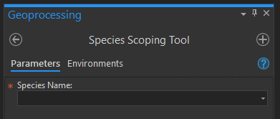
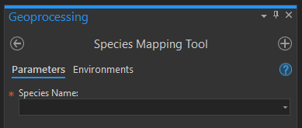
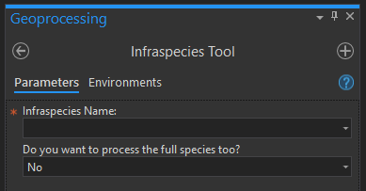
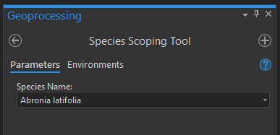
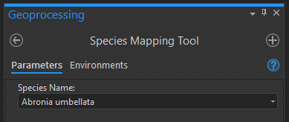
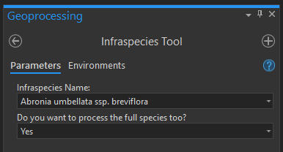
Tool execution
Species Scoping Tool
Species Mapping Tool
Infraspecies Tool
The tools are ready to run after you pick a species/infraspecies from the dropdown menu

Slide 6
Demo 1 – Running the tools &
exploring tool messages

Slide 7
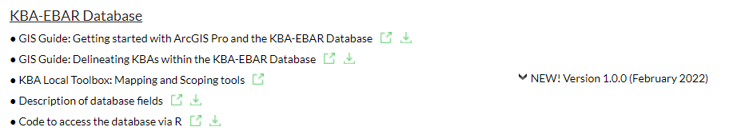
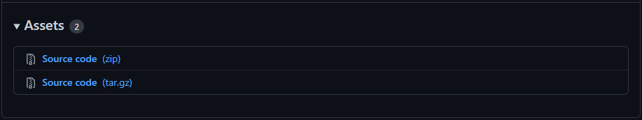
Download the toolbox (one time action)
1. Go to the KBA Wiki & click the link for the KBA Local Toolbox
2. Download the Source code (zip) from GitHub & unzip the file

Slide 8
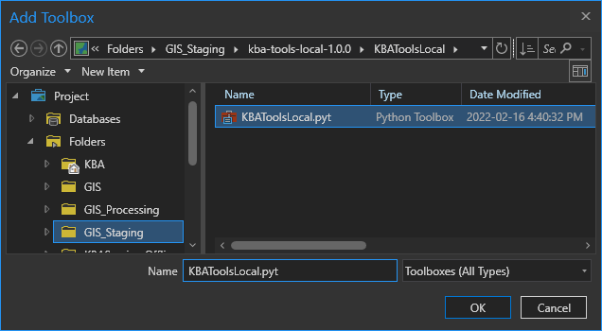
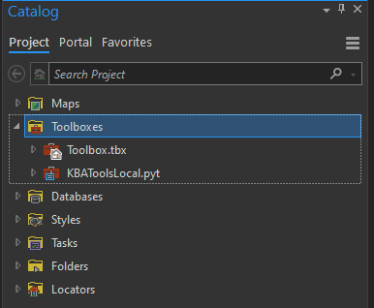
Add the toolbox in ArcGIS Pro (one time action)
Right click on Toolboxes > Add Toolbox
In the Add Toolbox window, browse to the location where you downloaded & unzipped the toolbox. Locate the KBAToolsLocal.pyt & click OK.

Slide 9
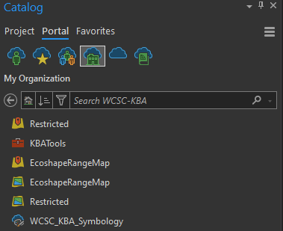
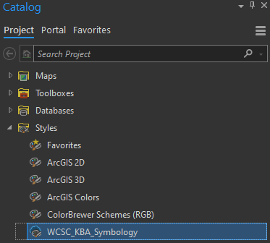
Add the custom symbology (one time action)
Browse in the Portal to the WCSC-KBA Group
Right click on WCSC_KBA_Symbology, then click Add Style.
Where to find the custom Style in Portal
Style location after it is added to your project

Slide 10
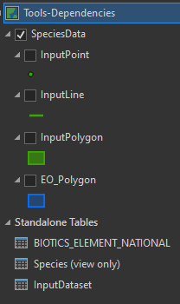
Tool dependencies (required data layers & tables)
Check that these data layers and tables are loaded in your map:
The tools will fail if:
If you have renamed any of them
If you have modified the structure of the SpeciesData group layer
If there are definition queries on any of these layers or tables
Recommendation for successful tool execution:
Re-add the WCSC-KBA Map File to your project from Portal & run the tools in this map.
You will have fewer errors when running the tools.
You can copy & paste the output results into other maps for KBA delineations and/or workshops.

Slide 11
Demo 2 – Installing the tools,
tool dependencies & error handling

